Slide 1
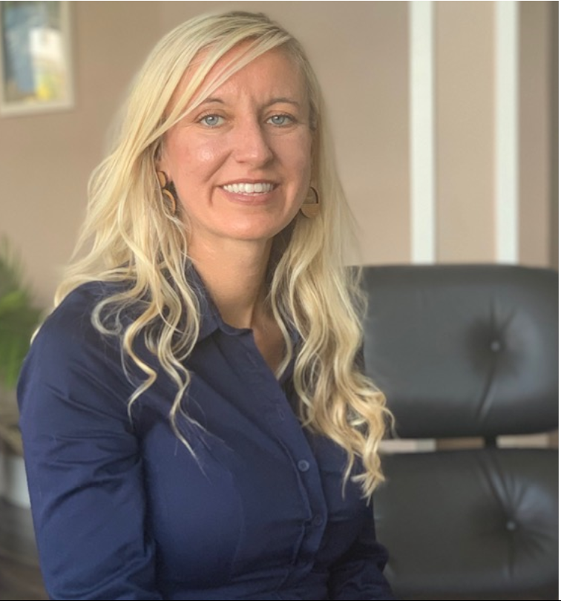
Jennifer Gibson
Sr VP of Global Planning, Logistics &Quality
In this role, Jennifer oversees manufacturing, supply chain operations, Warehouse & Distribution, enterprise intergrations and Quality Globally. In addition, Jennifer is the operations liaison for Group Brand Businesses and sales growth.
Jennifer has a background in product development, supply management, customer excellence, logistics and operations. Previous industries include automative, oil and appliances building collaborative relationships across the enterprise.
Western Grad in Supply Chain & MBA: International Business.
Complete H.A.L.I and MSU Women in Leadership.
Inforum Co-Chair Board Member

