Slide 1
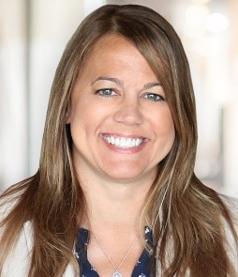
Jamie K. Simpson
Professional background
Jamie is an Assurance partner in the Detroit office of Ernst & Young LLP. She has 27 years of client service experience and extensive experience leading high performing teams in the audits of several global companies in the automotive, manufacturing, packaging and homebuilding industries.
Jamie has significant auditor transition experience, experience with IPOs, complex accounting and auditing matters, SEC filings, coordinating audits internationally, purchase accounting, shared service environments, auditing internal controls and International Financial Reporting Standards (IFRS). She brings significant experience serving SEC registrants and providing support related to external reporting and Sarbanes-Oxley Section 404 implementations and ongoing compliance.
Jamie has served several clients with significant foreign operations. She has had significant involvement with overseeing the work performed by EY component teams as part of the consolidated audit.
Jamie has also served as the engagement quality reviewer for several public and private clients.
Jamie has had significant involvement in the EY Detroit Professional Networks including the Today’s Family Network, Professional Women’s Network and other diversity, equity and inclusion initiatives. She serves as the Chair of the Board of Directors for Inforum and previously served as the Treasurer. Jamie served as the Michigan and Northwest Ohio Entrepreneur Of The Year™ Program Director for two years, where she oversaw the local program.
Personal
Jamie received a Bachelor of Arts with a major in Accounting from Michigan State University. She is a member of the American Institute of Certified Public Accountants (AICPA) and a member of the Michigan Association of CPA’s.
Jamie lives in a Detroit suburb with her husband Aaron and two children, Andrew and Riley.
Assurance Partner
Ernst & Young LLP
777 Woodward Avenue
Suite 1000
Detroit, MI 48226
Mobile: +1 248 978 2652
jamie.simpson@ey.com

