Slide 1
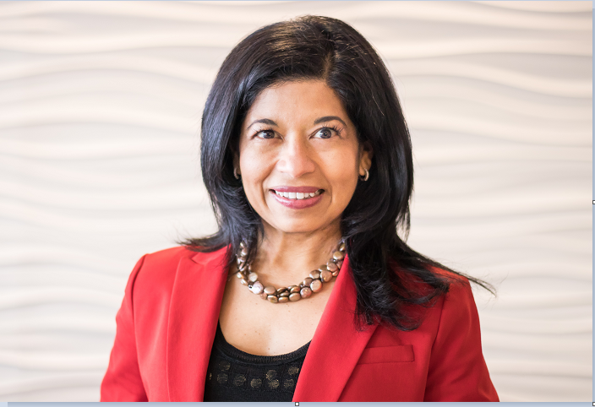
Menaka Abel-Hunter
Menaka Abel serves as the Chief Financial Officer for Request Foods. With a background in International Finance, Sales and Strategy across consumer goods and furniture industries, Menaka has held roles of increasing responsibility at companies such as Price Waterhouse, Steelcase and Amway.
Throughout her career, Menaka has been recognized across organizations for driving transformational results through strong leadership skills, business acumen and cross functional collaboration. Committed to the Servant Leadership principles, Menaka leads the Finance, Technology, Strategic Planning and Legal functions at Request.
Menaka operates under the principle that everyone deserves the opportunity to thrive, be successful and achieve their career goals. She was previously active in Amway’s Women’s Inclusion Network, mentors many young professionals and is an active advocate for women in leadership. Additionally, Menaka serves on the Board of Lakeshore Advantage and Kids Food Basket and is passionate about causes which combat childhood hunger and promote the health and development in children.
Menaka is originally from Sri Lanka and came over to the US during a time of civil war, earned a bachelor’s degree in Accounting from Hillsdale College, Michigan and holds a CPA license.
Menaka loves to cook; is a wine enthusiast and enjoys travel – especially to wine regions. She is deeply committed to her faith and cherishes spending time with family and friends.
Menaka Abel-Hunter
Chief Financial Officer
Request Foods Inc

